Slide 1

LearnPath
Student Learning & Course Enrollment Platform
Project
Overview
Presentation
A centralized web platform for instructors,
admins & students to manage learning journeys.
React
Spring Boot
MySQL
JWT Auth
React | Spring Boot | MySQL
Microservices Architecture
Group of 7 Members • Microservices Project • Case Study 09

Slide 2
👥 Team Members
M1
K. Leela Vyshnavi
M5
S. Firdose Banu
Auth & Security
Progress Tracking
M2
M. Shirisha
M6
P. Yellamma
Course Management
Instructor Dashboard
M3
Y. Kousalya
M7
K. Veera Kalpana
Lesson Management
Admin Approval
M4
K. Chaitanya Sri
Enrollment Service
Tech Stack: React.js • Spring Boot • MySQL • JWT Auth

Slide 3
Why LearnPath?
The challenges in online learning that this platform was built to solve
📚
Centralization Platform
🔐
Role Based Access
Students had no single unified portal to discover, browse, enroll, and track courses. Learning was fragmented across multiple disconnected tools with no integrated dashboard.
No system enforced separate permissions for Students, Instructors, and Admins. Everyone could access everything — leading to security gaps and chaotic management.
📋
Course Approval Workflow
📈
Progress Visibility
Instructors could publish content without any quality review. There was no admin gate — poor-quality courses would go live to students without oversight or approval.
Students had no way to track their learning journey. No system to record: Enrolled → In Progress → Completed. No sense of achievement or measurable momentum.
👨‍🏫
Instructor Management Tools
🏗️
Scalable Architecture
Instructors had no dashboard to manage courses, add structured lessons, or monitor which students enrolled and what their current progress was.
A monolithic system cannot scale independently per feature. A microservice design lets each concern be developed, tested, and deployed by a separate team member.
LearnPath — Student Learning & Course Enrollment Platform

Slide 4
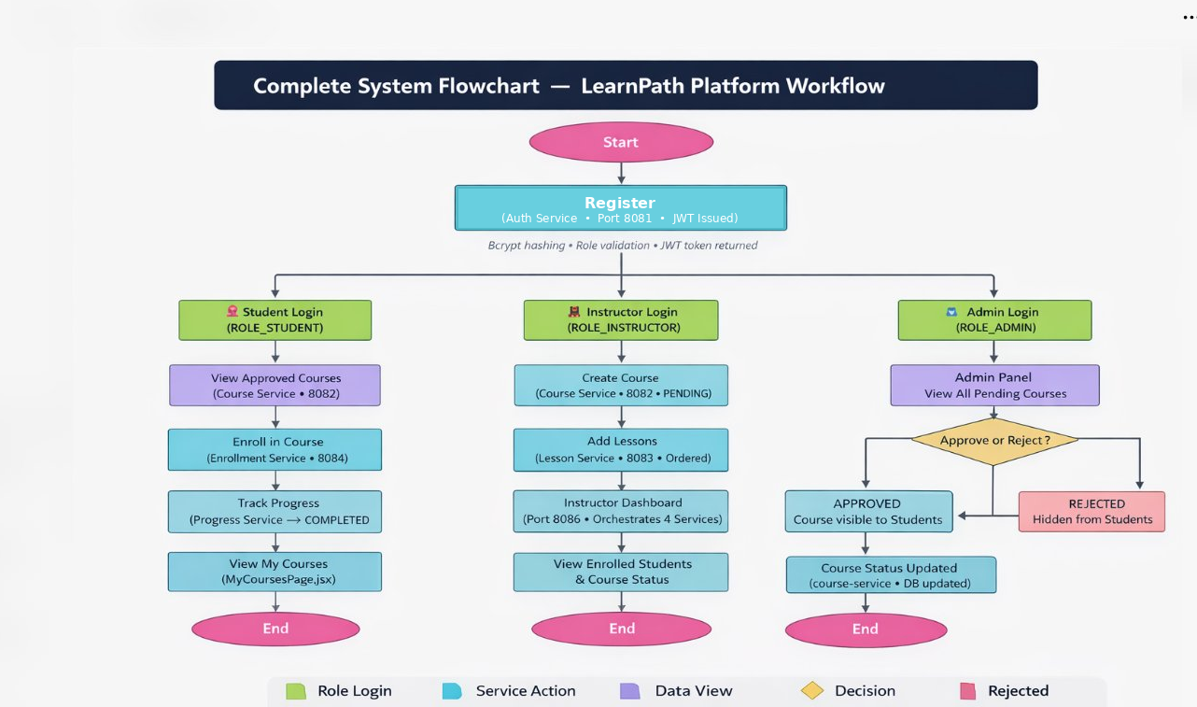

Slide 5
🔐 Authentication Flow
Registration Workflow — K. Leela Vyshnavi
User submits
Login Form
User submits
Register Form
Role-Based Redirect
STUDENT
/my-courses
POST /api/user/login
(email, password, role)
POST /api/user/register
(username, email, pass, role)
INSTRUCTOR
/instructor/dashboard
AuthService validates
credentials + role
BCrypt password hashed
+ User saved to DB
ADMIN
/admin/courses
JWT Token
Generated & Returned
JWT Token issued
+ Redirect to login
JWT stored in localStorage
Member 1 — K. Leela Vyshnavi | Auth Flow | Spring Security + JWT

Slide 6
🔐 User Authentication & Security Service
Member 1 — K. Leela Vyshnavi • FR-06
What This Service Does
API Endpoints & Files
Handles registration, login, and JWT-based authentication for all three roles (STUDENT, INSTRUCTOR, ADMIN). Secures all backend endpoints using Spring Security role guards. Key Technology: Spring Security + JWT Filter Chain Entity: User.java — id, username, password, email, role
POST
/api/user/register
Register any user role
POST
/api/user/login
Login & issue JWT token
Key Files:
AuthController.java • AuthService.java • User.java • UserRepository.java • JwtUtil.java • JwtFilter.java • SecurityConfig.java
Member 1 — K. Leela Vyshnavi | Auth & Security Service

Slide 7
📚 Course Creation & Management Service
Member 2 — M. Shirisha • FR-01, FR-04
Course.java Entity
API Endpoints
• id (Long)
POST
/api/instructor/course
• title (String)
Instructor creates course (status → PENDING)
• description (TEXT)
• category (String)
GET
/api/instructor/courses?instructorId=
• level (String)
Instructor views their own courses
• status (PENDING | APPROVED | REJECTED)
• instructor (User)
GET
/api/student/courses
• lessons (List<Lesson>)
Students browse only APPROVED courses
Member 2 — M. Shirisha | Course Service | CourseService.java + CourseController.java

Slide 8
📚 Course Lifecycle & Status Flow
From Creation to Student Visibility — M. Shirisha
Instructor
Creates Course
Status:
PENDING
Admin
Reviews
APPROVED
or REJECTED
→
→
→
POST /api/instructor/course
Waiting for admin review
GET /api/admin/courses
PUT /api/admin/course/{id}
Student Visibility after APPROVAL
getApprovedCourses()
getCoursesByInstructor()
updateCourseStatus()
Returns only APPROVED courses to student dashboard
Instructor sees own courses with PENDING/APPROVED/REJECTED status
Admin updates status — triggers visibility change for students
Member 2 — M. Shirisha | PENDING → APPROVED → Visible to Students

Slide 9
📝 Lesson Management Service
Member 3 — Y. Kousalya • FR-02
Lesson.java Entity
API & Service Methods
• id (Long)
POST
/api/instructor/lesson?courseId=
• title (String)
Instructor adds lesson; validates ownership
• content (TEXT)
• orderNumber (Integer)
GET
getLessonsByCourse(courseId)
Returns lessons sorted by orderNumber
• course (Course — Many-to-One)
Relationship:
Validation Rule:
Each Lesson belongs to ONE Course (Many-to-One). Lessons are ordered by orderNumber.
Authenticated instructor must OWN the course before adding a lesson — prevents unauthorized lesson injection.
Member 3 — Y. Kousalya | Lesson Management | LessonController + LessonRepository

Slide 10
📝 Lesson Ordering & Sequencing
How Students See Course Content in Order — Y. Kousalya
Instructor Adds Lessons with orderNumber:
1
2
3
→
→
Introduction to the Course
Core Concepts & Theory
Practical Implementation
Overview, goals, prerequisites
Main concepts explained with examples
Hands-on tasks and real code
Backend: getLessonsByCourse() in CourseService.java
Fetch
Sort
Return
→
→
Find all lessons where course_id matches
Order by orderNumber ASC
Ordered List<Lesson> to frontend
Member 3 — Y. Kousalya | Lessons ordered by orderNumber — students always see correct sequence

Slide 11
🎓 Student Enrollment Service
Member 4 — K. Chaitanya Sri • FR-03
Enrollment.java Entity
API Endpoints
• id (Long)
POST
/api/student/enroll?courseId=&studentId=
• student (User — Many-to-One)
Student enrolls; status → ENROLLED
• course (Course — Many-to-One)
GET
/api/student/enrollments?studentId=
• enrollDate (LocalDate)
Student views all enrolled courses
• progressStatus (ENROLLED | IN_PROGRESS | COMPLETED)
Duplicate Prevention:
Repository Methods:
findByStudentAndCourse() checks existing enrollment before saving to prevent duplicate records.
• findByStudent(student)
• findByCourse(course)
• findByStudentAndCourse(s,c)
Member 4 — K. Chaitanya Sri | EnrollmentService.java + EnrollmentRepository.java

Slide 12
🎓 Enrollment Workflow
One-Click Enrollment Process — K. Chaitanya Sri
Student browses
APPROVED courses
Clicks ENROLL
button
Create Enrollment
status = ENROLLED
Duplicate check:
already enrolled?
→
→
→
NO ↓
YES → Return error
"Already Enrolled"
EnrollmentService.java Methods
enrollStudent()
getEnrollmentsByStudent()
Validates + saves enrollment with status ENROLLED
Returns all enrollments for a student with course details
Member 4 — K. Chaitanya Sri | One-click enrollment with duplicate prevention

Slide 13
📈 Progress Tracking Service
Member 5 — S. Firdose Banu • FR-04
Progress Status Flow:
ENROLLED
→
IN_PROGRESS
→
COMPLETED
On first enrollment
Student starts the course
Course fully finished
API Endpoints
Response Shape
GET
/api/student/enrollments?studentId=
• courseTitle (String)
Returns all enrolled courses + progress status
• instructorName (String)
PUT
/api/student/progress?enrollmentId=&status=
• enrollDate (LocalDate)
Student updates progress via query param
• progressStatus (ENROLLED | IN_PROGRESS | COMPLETED)
Member 5 — S. Firdose Banu | updateProgressStatus() in EnrollmentService.java

Slide 14
📈 Student Progress Dashboard
My Courses View — S. Firdose Banu
📚 My Enrolled Courses
Java Spring Boot Fundamentals
COMPLETED
100%
Instructor: Instructor A
React.js for Beginners
IN_PROGRESS
60%
Instructor: Instructor B
MySQL Database Design
ENROLLED
10%
Instructor: Instructor C
PUT /api/student/progress?enrollmentId=&status= → Updates progress in real-time
Member 5 — S. Firdose Banu | ENROLLED → IN_PROGRESS → COMPLETED

Slide 15
👨‍🏫 Instructor Dashboard Service
Member 6 — P. Yellamma • FR-01, FR-02, FR-06
Role & Responsibilities
API Endpoints
Acts as the controller layer for all Instructor operations. Orchestrates CourseService and EnrollmentService together and gives instructors visibility into their enrolled student lists.
POST
/api/instructor/course
Create new course (→ PENDING)
GET
/api/instructor/courses?instructorId=
• InstructorController.java — consolidates all instructor endpoints
View own courses list
• Wires CourseService + EnrollmentService for instructor workflows
POST
/api/instructor/lesson?courseId=
Add lesson to a course
• Response shaping: course list with lesson count & enrolled student count
GET
/api/instructor/students?courseId=
• Input validation and error handling for all instructor API requests
View all enrolled students for a course
Member 6 — P. Yellamma | InstructorController.java — orchestrates all instructor workflows

Slide 16
👨‍🏫 Instructor Dashboard UI
InstructorDashboard.jsx — P. Yellamma
4
18
56
My Courses
Lessons Created
Enrolled Students
My Courses
Spring Boot Advanced
5 Lessons
22 Students
APPROVED
Java Basics
8 Lessons
14 Students
PENDING
Microservices 101
5 Lessons
20 Students
APPROVED
GET /api/instructor/courses • GET /api/instructor/students?courseId=
Member 6 — P. Yellamma | Instructor sees course list + lesson count + enrolled students

Slide 17
🛠️ Admin Course Approval Service
Member 7 — K. Veera Kalpana • FR-05
Service Description
API Endpoints
Provides the admin approval portal. Admins review all pending courses and approve or reject them — the gate that controls whether a course becomes visible to students.
GET
/api/admin/courses
Admin views ALL courses regardless of status
PUT
/api/admin/course/{courseId}?status=APPROVED
Approves a pending course
✦ AdminController.java
PUT
/api/admin/course/{courseId}?status=REJECTED
✦ approveCourse() in CourseService.java
Rejects a pending course
✦ rejectCourse() in CourseService.java
GET
/api/admin/users
Admin views all registered users with roles
✦ GET /api/admin/users — view all registered users
Member 7 — K. Veera Kalpana | AdminController.java — course approval gateway

Slide 18
🛠️ Admin Course Approval Panel
AdminCoursesPage.jsx — K. Veera Kalpana
🛠️ Admin — Course Approval Portal
9
3
5
1
Total Courses
Pending
Approved
Rejected
Courses Pending Review
Python for Data Science
APPROVE
REJECT
Instructor X | Data
Advanced React Patterns
APPROVE
REJECT
Instructor Y | Frontend
Docker & Kubernetes
APPROVE
REJECT
Instructor Z | DevOps
Member 7 — K. Veera Kalpana | PUT /api/admin/course/{id}?status=APPROVED or REJECTED

Slide 19
LearnPath is a platform where students can learn the courses that are created by the instructor and approved by the admin.
Thank You!
LearnPath — Student Learning & Course Enrollment Platform
React.js Frontend
Spring Boot Microservices
MySQL Database
JWT Security
Team Members
K. Leela Vyshnavi • M. Shirisha • Y. Kousalya • K. Chaitanya Sri
S. Firdose Banu • P. Yellamma • K. Veera Kalpana
Microservices Project • Case Study 09 • React | Spring Boot | MySQL

